Slide 1
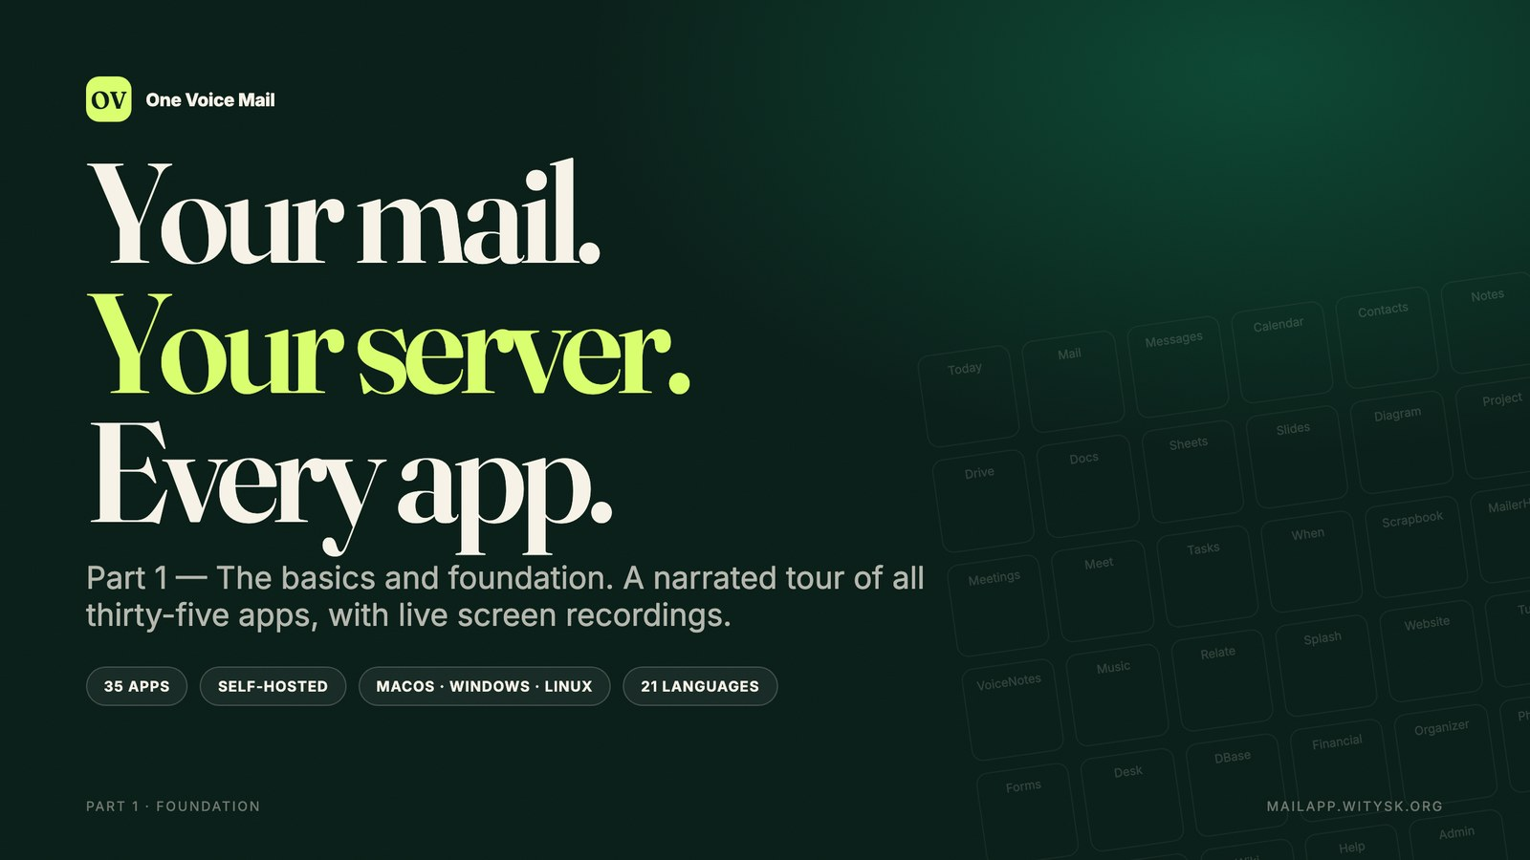
Notes:
Jo: Welcome to One Voice Mail — the self-hosted workspace that replaces Google Workspace and Microsoft 365.
Alex: In the next nine minutes, we will show you all thirty-five apps.
Maya: Not as a slide deck — in the real product, with real data.
Sam: This is part one: the basics and the foundation.
Jo: Let's begin.

Slide 2
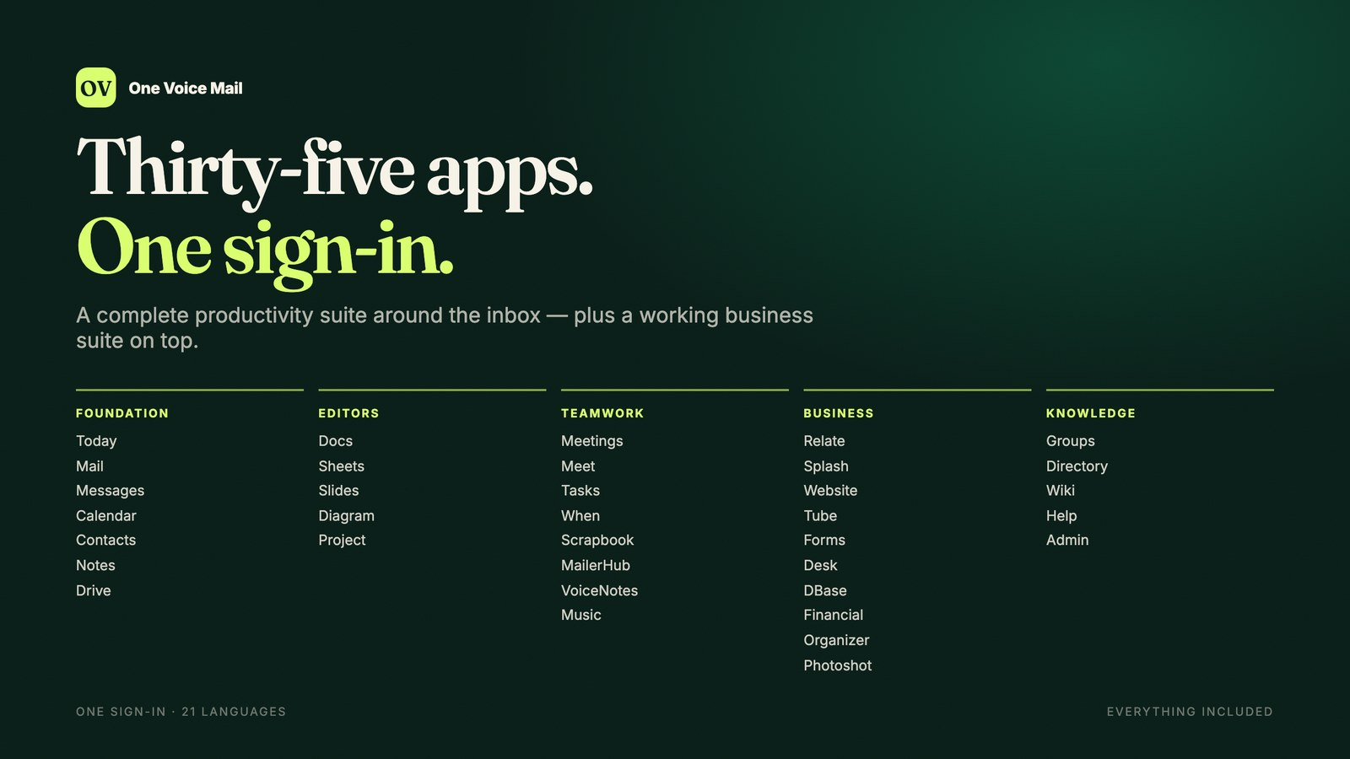
Notes:
Jo: One sign-in opens a complete suite. Mail, Calendar, Contacts, Notes and Drive are the foundation.
Alex: Around them sit five Office-compatible editors, chat, meetings, tasks, polls, voice notes, campaigns, research, music — and a full business suite.
Maya: Thirty-five apps in total, in twenty-one languages.
Sam: On a server you choose, with native desktop apps for macOS, Windows and Linux.
Jo: There is no per-seat licence, and no app is an upsell.
Alex: Every app in this tour is included in the same account.
Maya: So let's start where the day starts: the inbox.

Slide 3
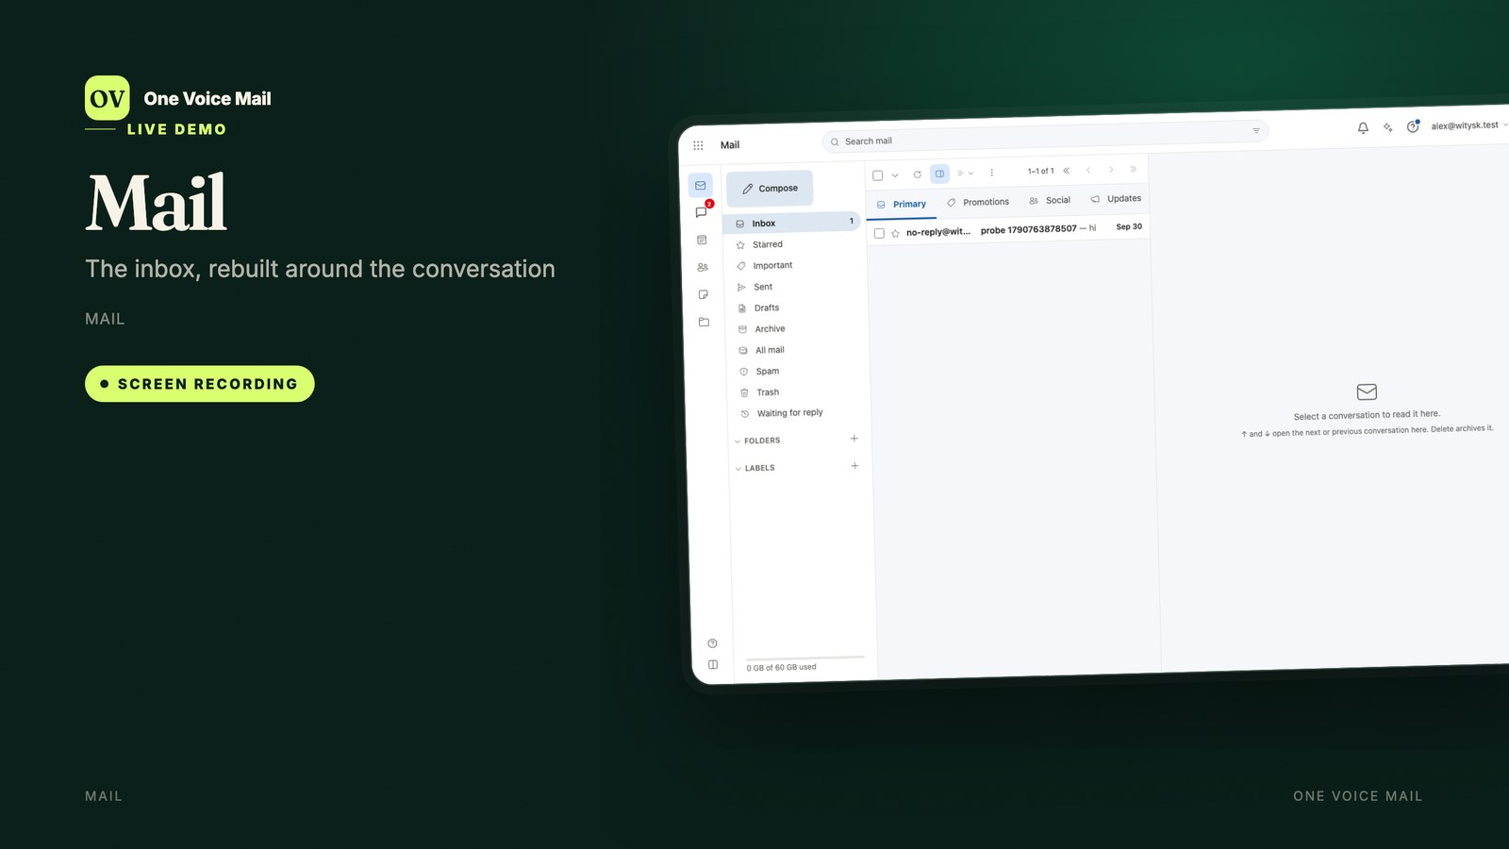
Notes:
Alex: Everything starts in Mail. Conversations are single rows, so archiving, labelling or snoozing applies to the whole thread.
Maya: I can search with Gmail-style operators — from, subject, has attachment, before — and turn a sentence into a filter.
Sam: Schedule send runs on the server, so it still goes out when your laptop is closed.
Alex: And Undo send gives you five to thirty seconds to change your mind.
Maya: Filters and rules run server-side, with your computer off, in every mail app.
Sam: A screener holds first-time senders until you allow or block them.
Alex: There are category tabs, smart chips for invoices and parcels, and AI summaries when you opt in.
Maya: Remote images are blocked by default and loaded through a signed proxy.
Sam: S/MIME and PGP are built in, for signing and encryption.
Alex: And every message can become an event, a task, a note or a document.

Slide 4
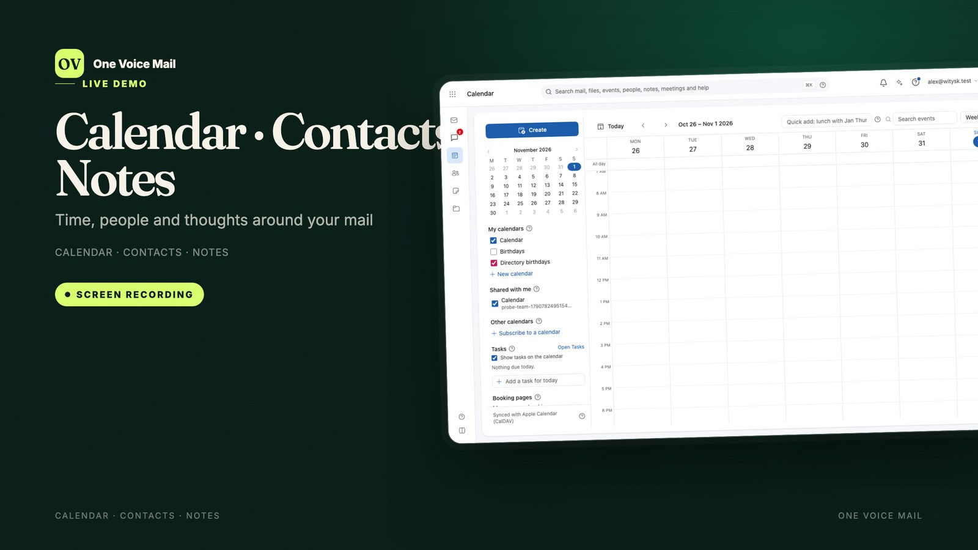
Notes:
Jo: Calendar is full CalDAV: day, week, month, year and agenda, shared calendars, booking pages and free-busy.
Sam: It syncs with Apple Calendar, Outlook, Thunderbird and Android.
Alex: Invitations can be accepted, declined, or answered with another time.
Maya: Contacts is CardDAV, with relationship cards: recent mail, meetings and shared files for each person.
Alex: Duplicate detection merges records after review.
Maya: Notes handles checklists, pictures, files and drawings.
Sam: And because notes are stored in the mail account, Apple Notes on iPhone, iPad and Mac can read them.
Jo: Small, shared, and always in step.

Slide 5
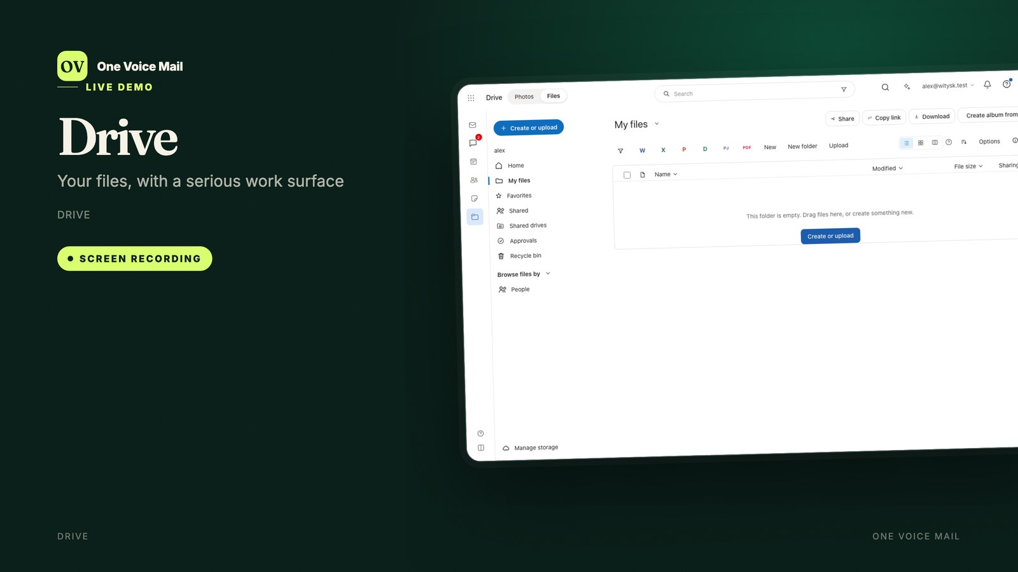
Notes:
Alex: Drive is the shared foundation: versions, comments, approvals, e-signature, file requests, retention and WebDAV.
Sam: About a hundred file types preview, and PDFs and images can be annotated.
Maya: Sharing is per person or by link, with an optional password and expiry.
Jo: Shared drives survive when a person leaves.
Alex: You can mount Drive in Finder, map it on Windows, or use WebDAV on Linux.
Maya: Every document, sheet, slide, diagram and plan lives here — and opens in the editor that owns it.
Sam: Versions are kept for thirty days, then daily for a year, then monthly for five years.

Slide 6
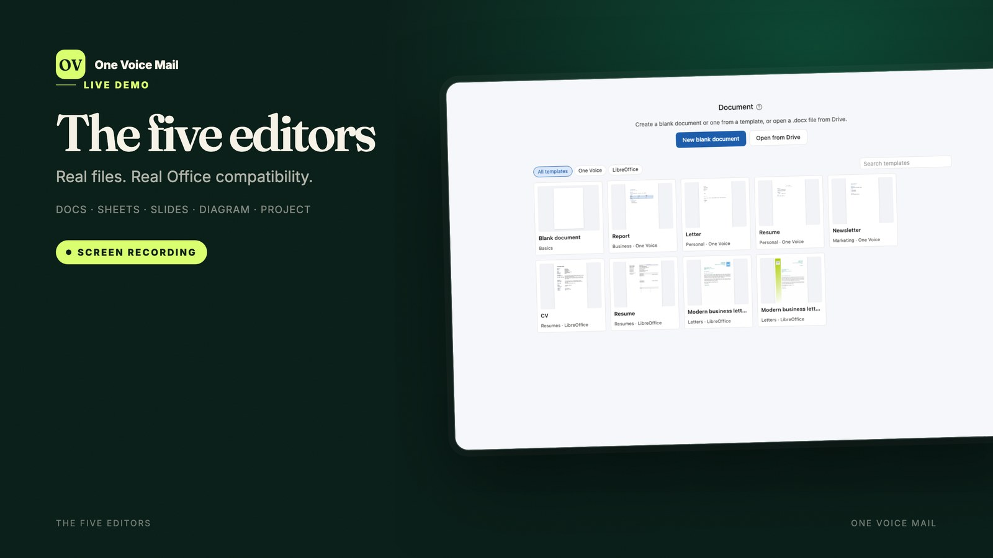
Notes:
Alex: Five editors, real Office formats. Docs opens and saves .docx, with track changes, comments and live co-editing.
Sam: Sheets is .xlsx: three hundred functions, PivotTables, charts, and server-side calculation that follows Excel rules.
Maya: Slides is .pptx, with presenter view and speaker notes.
Jo: Diagram edits OmniGraffle and Visio files, with stencils, magnets and auto-layout.
Alex: Project edits OmniPlan and Microsoft Project XML, with Gantt, dependencies, critical path and earned value.
Sam: There is no export path — the file is the file.
Maya: And Mail Desktop runs the same five editors on your local disk.
Jo: Which means the files your colleagues send just open.

Slide 7
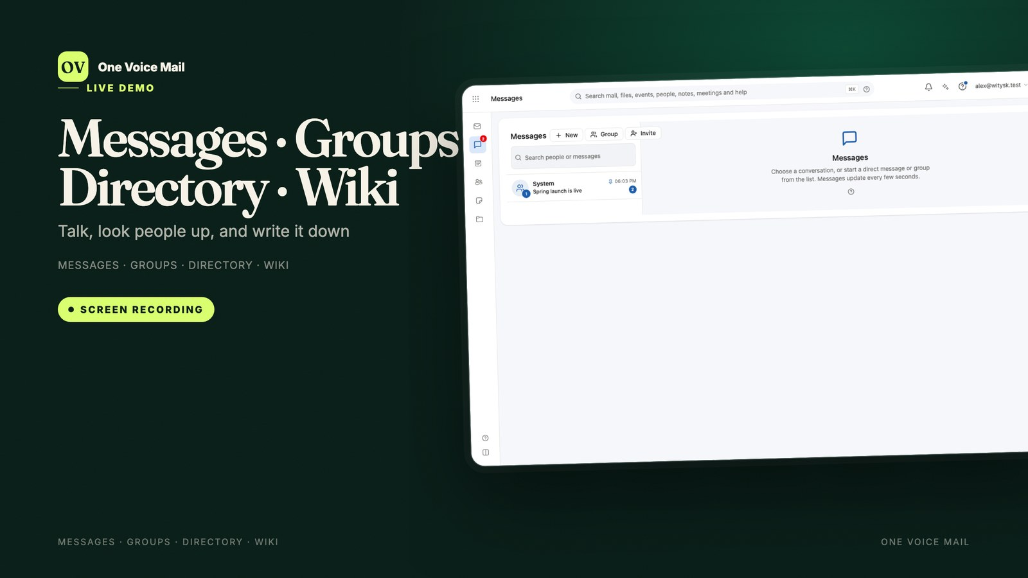
Notes:
Maya: Messages is chat: direct or group, with files, replies and read ticks.
Alex: Groups turns an address like support at your domain into a shared inbox or a forwarder, with nested membership.
Sam: Directory is everyone on your domains, with their card. Only your own card is editable.
Jo: Wiki is the encyclopedia: linked pages, a revision history, and public read-only addresses when you want them.
Maya: A public Wiki needs no account.
Alex: And every one of these apps appears in the same taskbar, search and notifications.
Sam: No separate product to buy, and no second password.

Slide 8
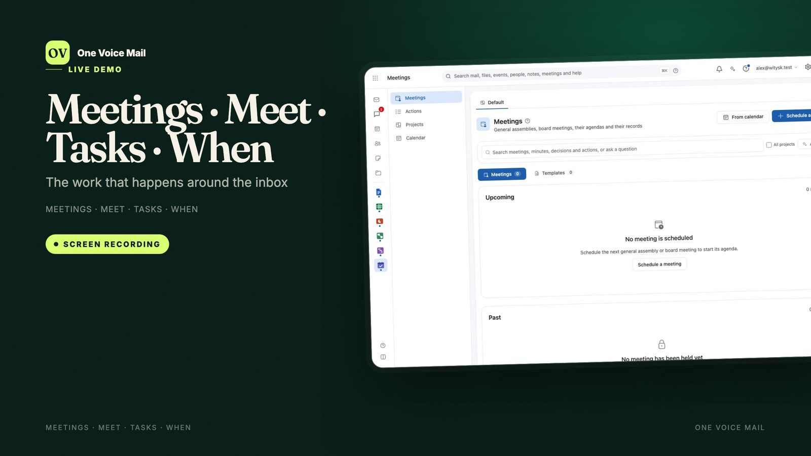
Notes:
Alex: Meetings keeps the agenda, attendance, decisions and minutes — and minutes can be sealed and approved.
Maya: Actions become Tasks. Tasks has Today, Upcoming and Overdue, with natural-language dates.
Sam: When is for finding a date: yes, if need be, or no, with public links for people outside.
Jo: And Meet drops a video call into the taskbar while you keep working.
Maya: Recurring meetings, papers, votes and proxies are all in the same record.
Alex: Tasks syncs both ways with Apple Reminders over CalDAV.
Sam: So the plan and the calendar do not drift apart.

Slide 9
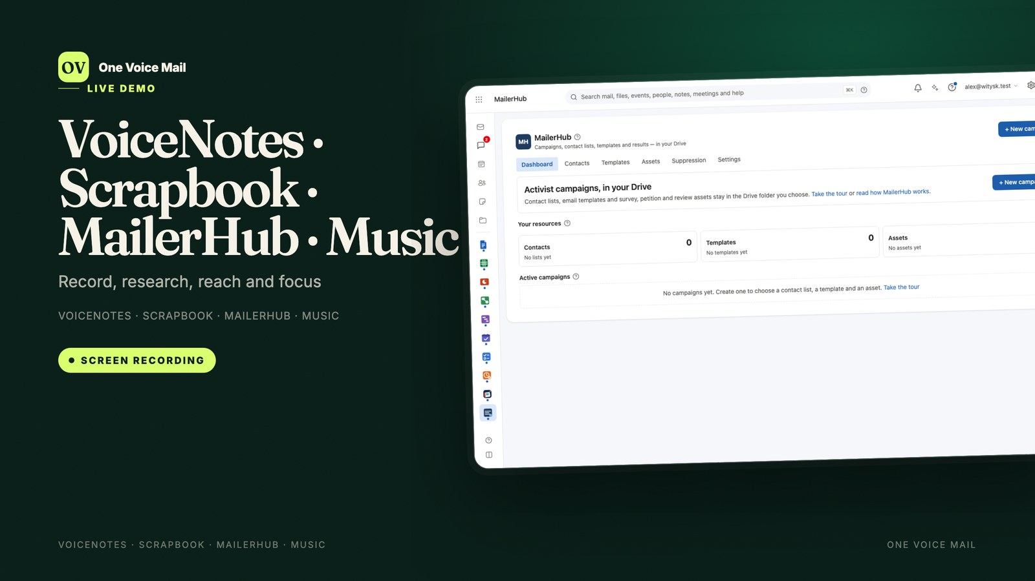
Notes:
Maya: VoiceNotes records, cleans up and transcribes, with timestamps and an AI summary.
Alex: Scrapbook collects posts, articles, videos and files onto boards, and summarises them.
Jo: MailerHub runs campaigns in six stages, with segments, A/B tests and reports.
Sam: Music is there for focus: charts, playlists and radio, in a mini-player that follows you across apps.
Maya: VoiceNotes keeps recordings as files in a Drive folder called Voice notes.
Alex: Scrapbook crawls sources in the background, so the board fills itself.
Jo: And MailerHub sends through your own mailbox, with one-click unsubscribe.

Slide 10
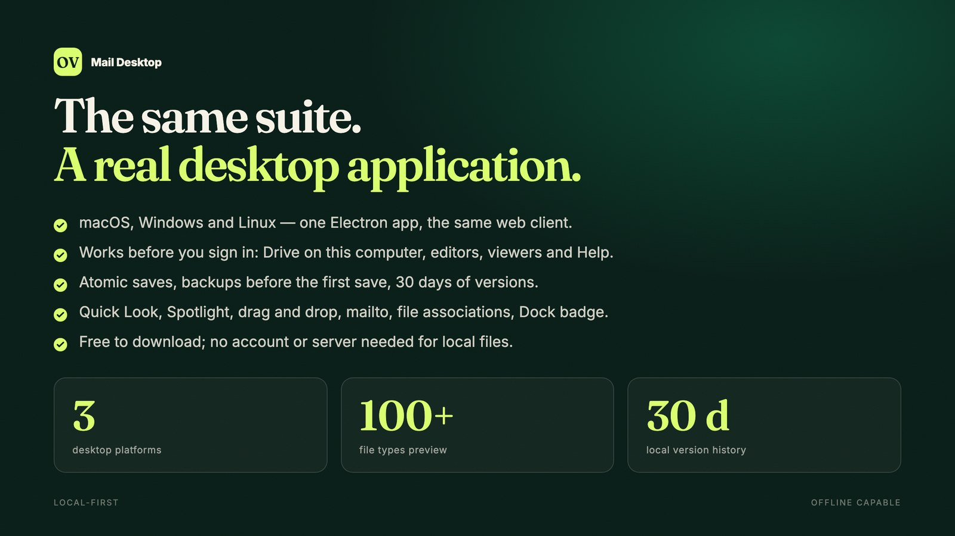
Notes:
Sam: Mail Desktop is the same suite as a real application — and it works before you sign in.
Alex: Drive on this computer shows your local folders beside your account. Word files open in Docs, Excel files in Sheets, PowerPoint in Slides.
Maya: Saves are atomic, backups are kept for thirty days, and a conflict asks before replacing your version.
Jo: Quick Look, Spotlight, drag and drop, mailto, file associations and the Dock badge are all wired in.
Sam: macOS, Windows and Linux. Free to download, and free to use locally.
Alex: Sign in when you want the server, and everything local keeps working offline.

Slide 11
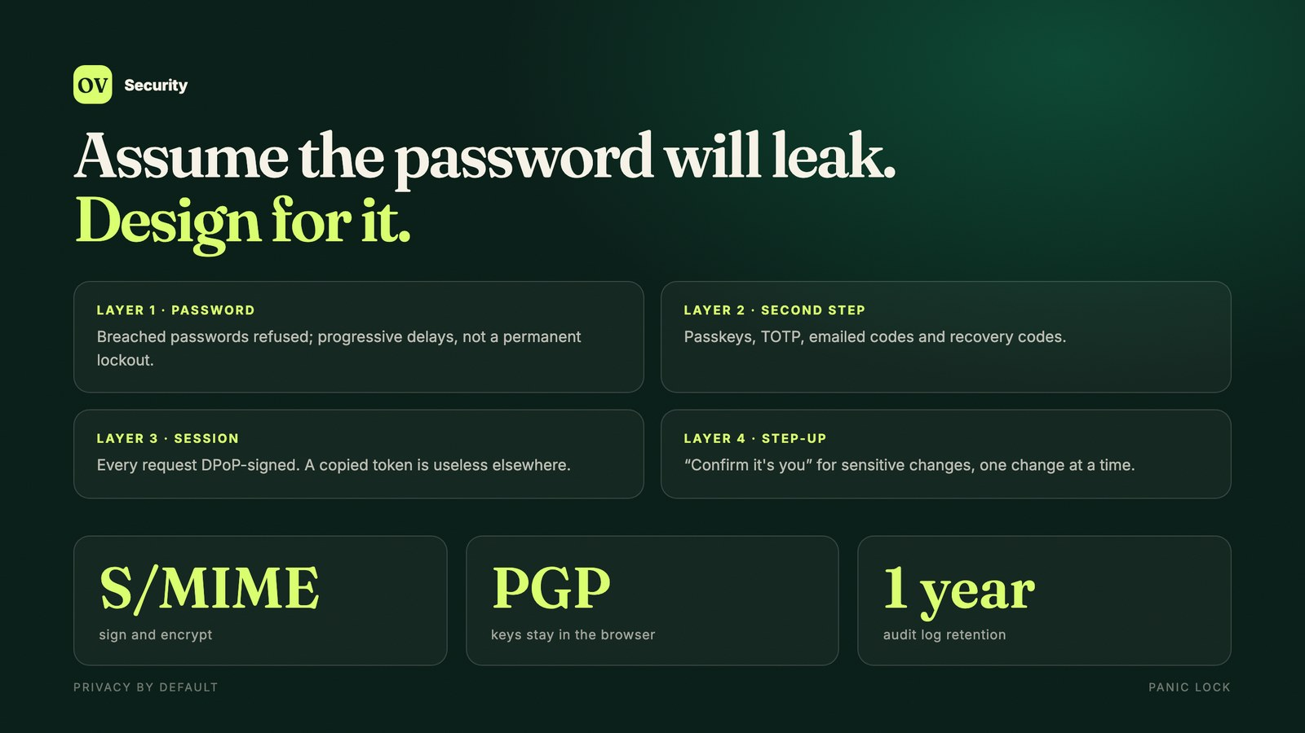
Notes:
Sam: Security assumes the password will leak. Breached passwords are refused, and passkeys replace both password and second step.
Alex: Every request is DPoP-signed, so a copied token is useless on another device.
Jo: Mail can be signed and encrypted with S/MIME or PGP, and private keys stay in the browser behind a passphrase.
Sam: Sensitive changes ask you to confirm it is you.
Maya: Sessions are listed per device, and a panic lock ends them all.
Alex: Administrators see audit events with address, time and IP.
Jo: The audit log is kept for a year; mail server logs for thirty days.
Sam: And admin itself requires a session with a second factor.

Slide 12
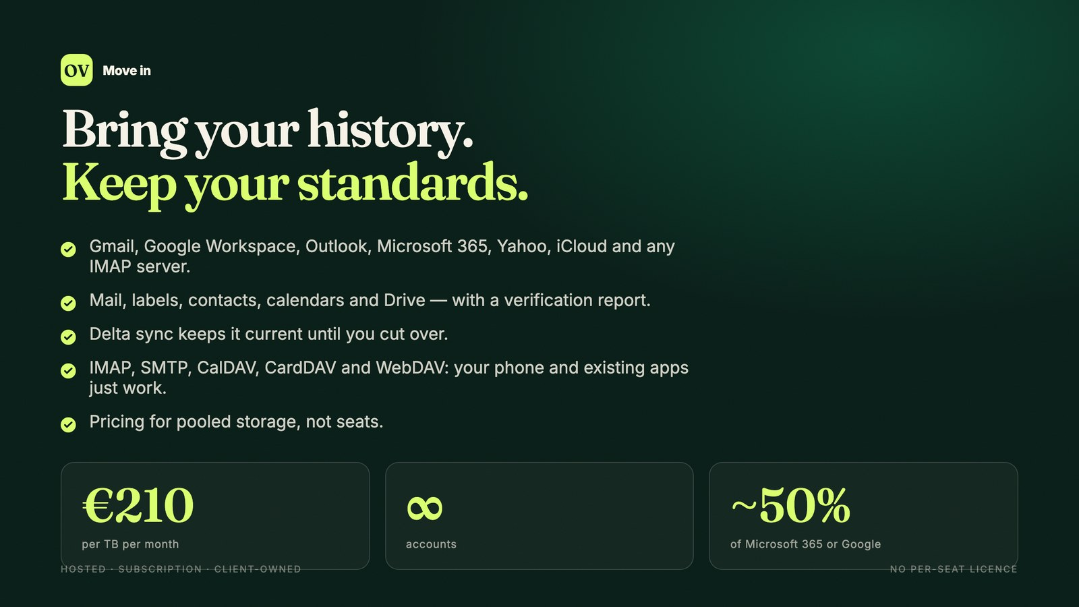
Notes:
Jo: Moving in does not mean leaving history behind. Gmail, Google Workspace, Outlook, Microsoft 365, Yahoo, iCloud and any IMAP server can be imported — mail, labels, contacts, calendars and Drive.
Maya: Delta sync keeps it current until you cut over, and a verification report compares counts.
Alex: Open standards mean Apple Mail, Outlook, Thunderbird and your phone just work.
Sam: The pricing model charges for pooled storage, not seats: two hundred and ten euros per terabyte per month, unlimited accounts, every app included.
Jo: About half of Microsoft 365 or Google Workspace for a typical hundred-person company.
Maya: Hosted, subscription, or on your own hardware.

Slide 13
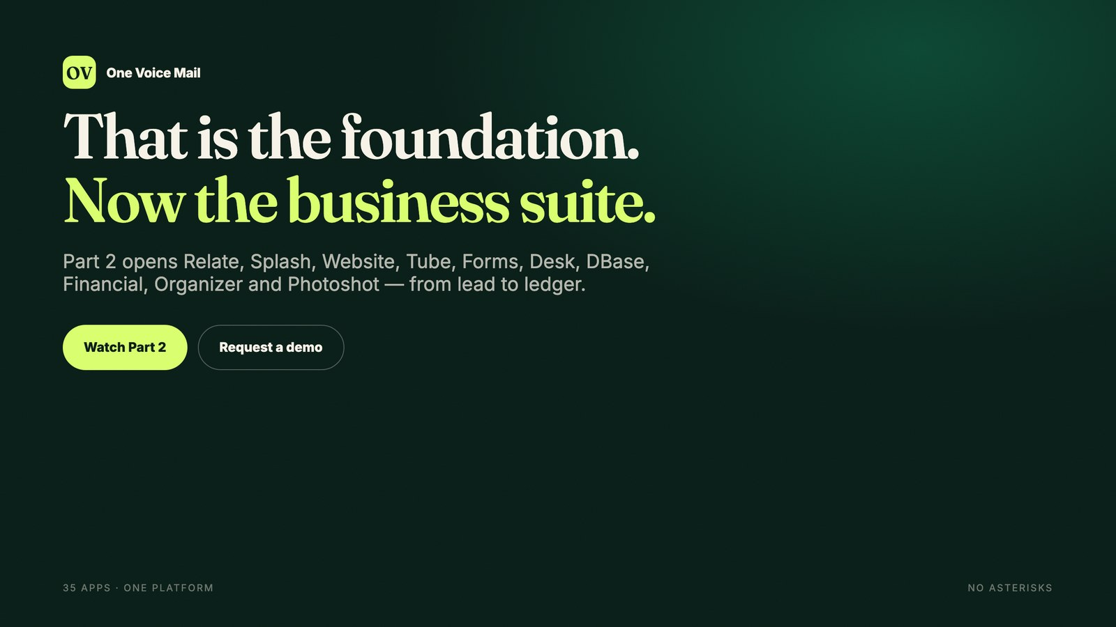
Notes:
Jo: That is the foundation: a complete productivity suite you own, on your own server.
Alex: In part two, we open the business suite: Relate, Splash, Financial, Organizer, Desk, Forms and more.
Maya: From lead to ledger — in the same place as your mail.
Sam: One platform. Thirty-five apps. No asterisks.
Jo: Thank you for watching.

