Slide 1
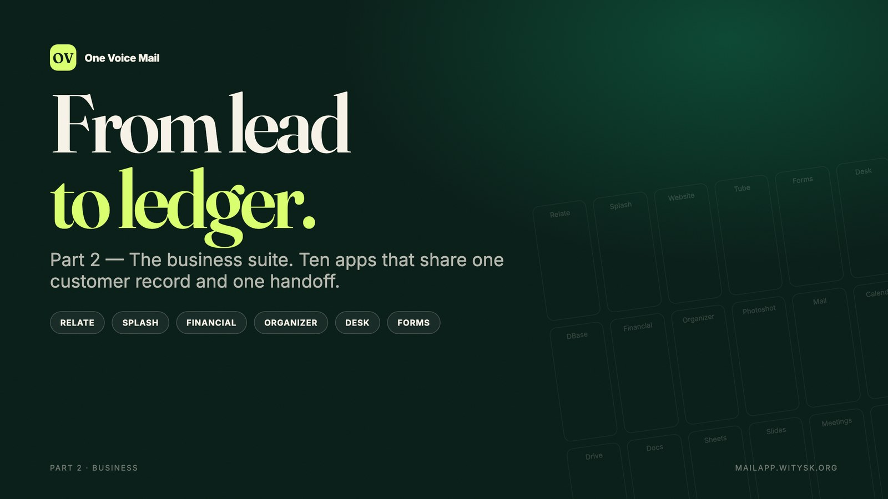
Notes:
Jo: Welcome back to One Voice Mail. This is part two: the business suite.
Alex: Ten apps that turn a contact into a customer, a campaign into revenue, and delivery into an invoice.
Maya: Relate, Splash, Website, Tube, Forms, Desk, DBase, Financial, Organizer and Photoshot.
Sam: All in the same account as your mail.
Jo: Let's follow the work.

Slide 2
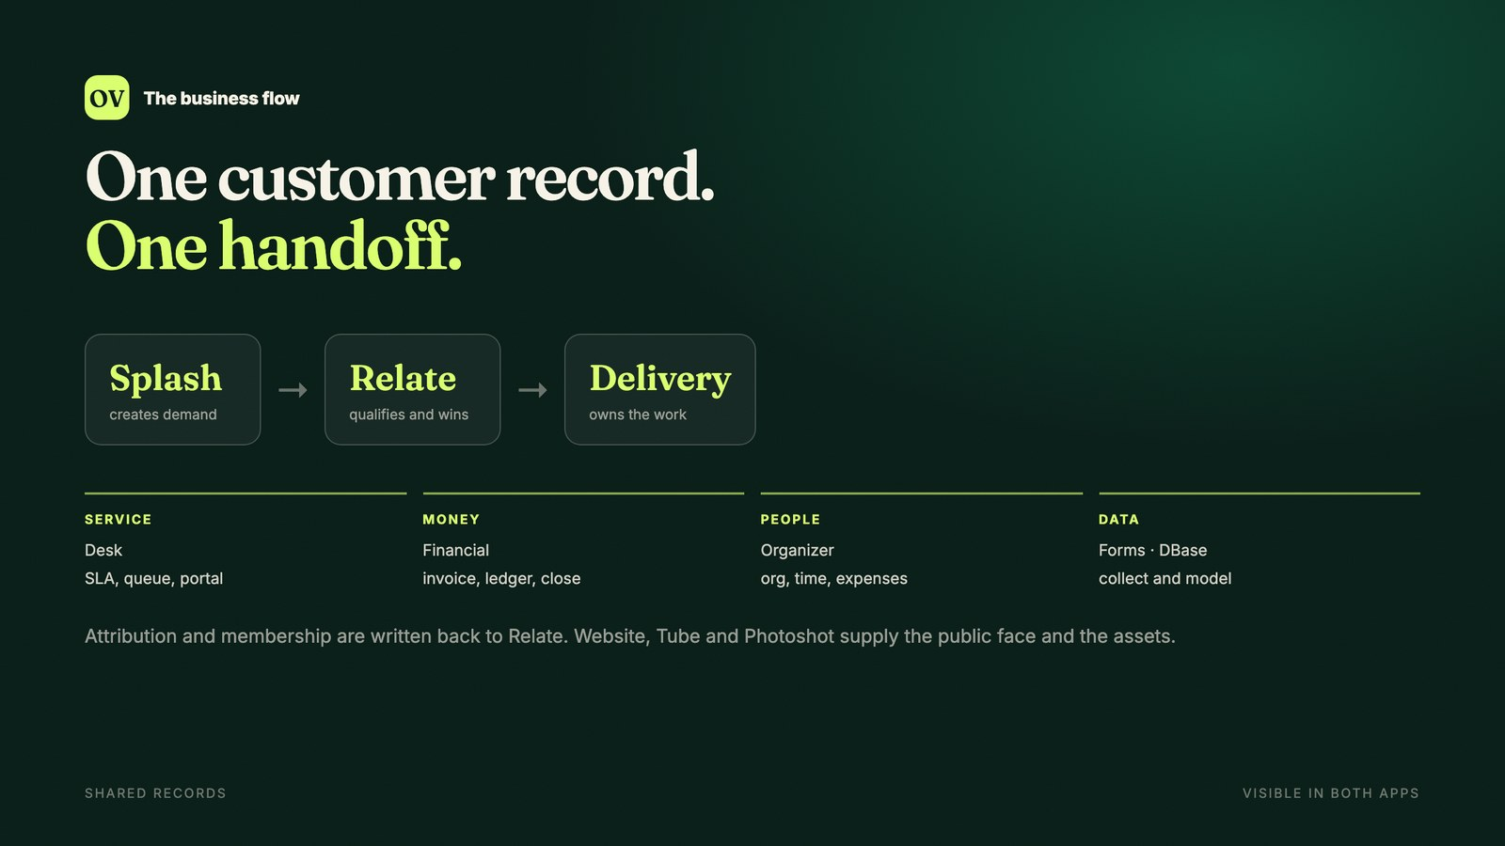
Notes:
Jo: The business apps share one flow. Splash creates demand. Relate qualifies and wins. Then the app that owns delivery takes over.
Alex: Desk for service, Financial for the ledger, Organizer for people and time, Forms for collection, DBase for data.
Maya: They share the same customer record, so nothing is copied between tools.
Sam: A campaign writes membership and attribution back to Relate.
Alex: A won opportunity can be handed to Financial or Organizer in one action.
Jo: And every handoff is visible in both apps.
Maya: Let's start with the customer record.
Sam: And because it is one account, permissions and search work across every app, not just one product family.
Alex: The same customer, the same files, and the same conversation history.

Slide 3
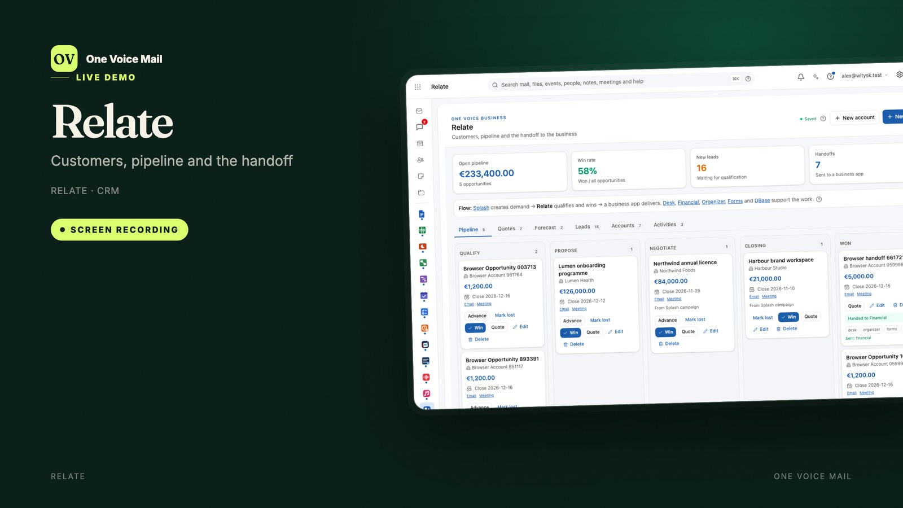
Notes:
Alex: Relate is the CRM: leads, accounts, contacts, opportunities and activities.
Maya: Leads arrive from Splash, a Forms form, a manual entry or an import — with consent shown before conversion.
Sam: Accounts can have many contacts and many opportunities.
Jo: Opportunities move through Qualify, Propose, Negotiate and Closing.
Alex: Quotes carry products, discounts and an expiry date, and acceptance is recorded.
Maya: The overview shows open pipeline, win rate, new leads and handoffs.
Sam: A won opportunity can be handed to a business app without re-entering anything.
Alex: Activities keep the next action visible.
Jo: And every campaign that touched the record is shown.

Slide 4
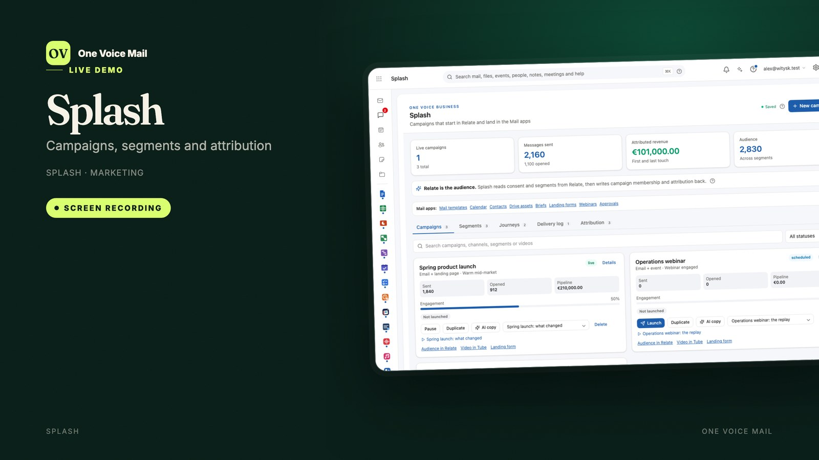
Notes:
Maya: Splash turns a Relate audience into a campaign and writes the result back.
Alex: Campaign calendar, segments, membership, email builder, brand templates and personalisation.
Sam: A/B testing, frequency guardrails, nurture journeys and lead scoring.
Jo: Landing pages come from Forms, assets from Drive, events from Calendar and Meet.
Maya: UTM attribution and ROI reporting show what the campaign earned.
Alex: Consent and deliverability are checked before launch.
Sam: AI copy runs with guardrails, and approvals are recorded.
Jo: And a failed delivery can be retried, paused, resumed or duplicated.

Slide 5
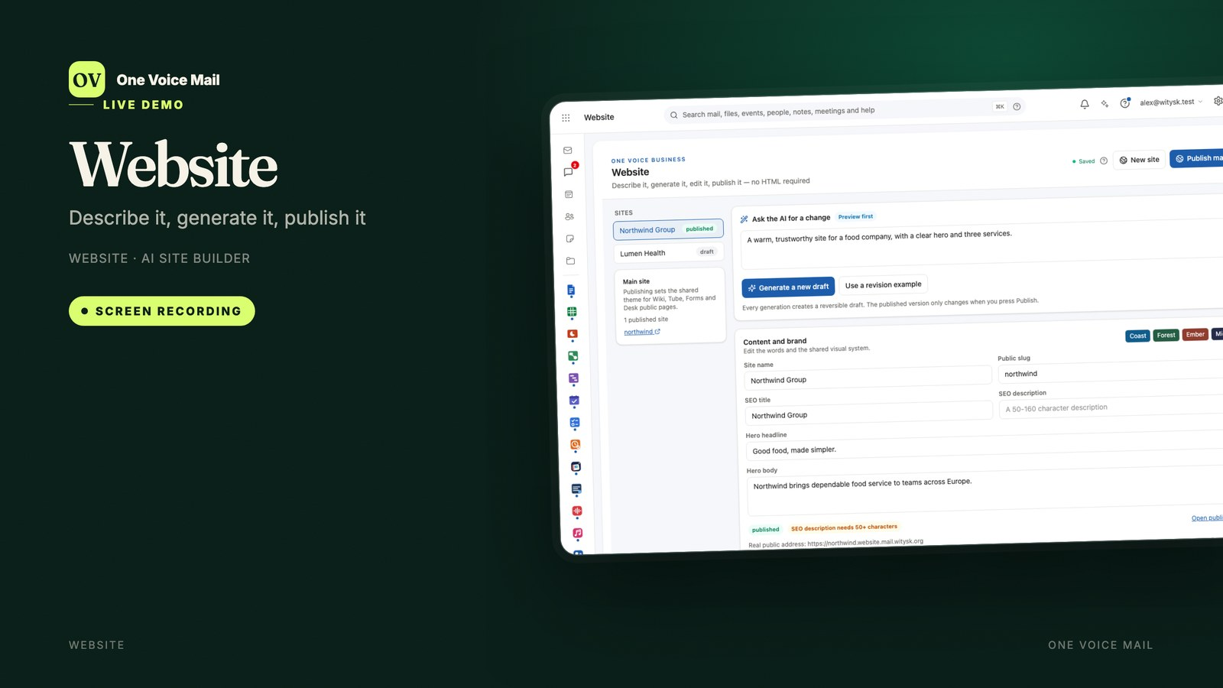
Notes:
Jo: Website is the AI-first site builder. Describe the site in plain words and it generates a reversible draft.
Alex: Then edit the headline, body, pages and theme without HTML.
Maya: Publishing is a separate, explicit action with SEO and accessibility checks.
Sam: Each site gets a public sub-domain, and the published theme becomes the suite's shared design.
Jo: So Wiki, Tube, Forms and Desk public pages look like the same organisation.
Maya: Every generation is a draft; nothing goes live by accident.
Sam: You can restore any previous version, and the public address is yours on your own domain.
Alex: No separate hosting account, and no plugin to maintain.

Slide 6
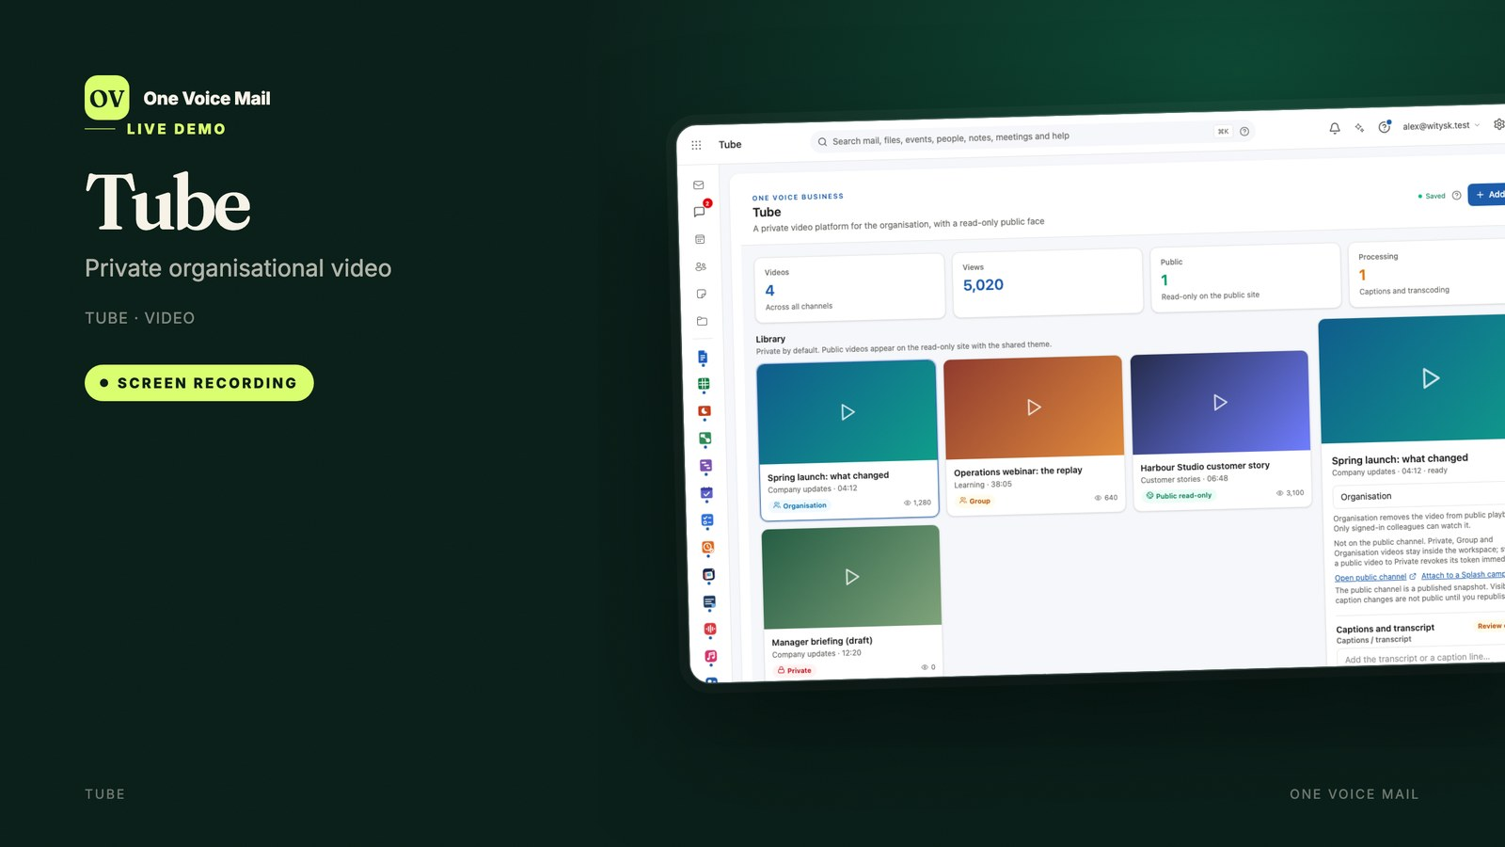
Notes:
Alex: Tube keeps the organisation's video in one place.
Maya: A video is private by default. The owner chooses private, group, organisation or public read-only.
Sam: Public playback is play-only: no upload, no comments.
Jo: Captions and transcripts sit in the player panel, and public playback includes the caption track.
Alex: Upload and transcode, delete, and see view counts.
Maya: And a video can be attached to a Splash campaign.
Sam: Visibility is set per video, and public access can be revoked at any time.
Alex: Channels keep the library organised by team, project or campaign.

Slide 7
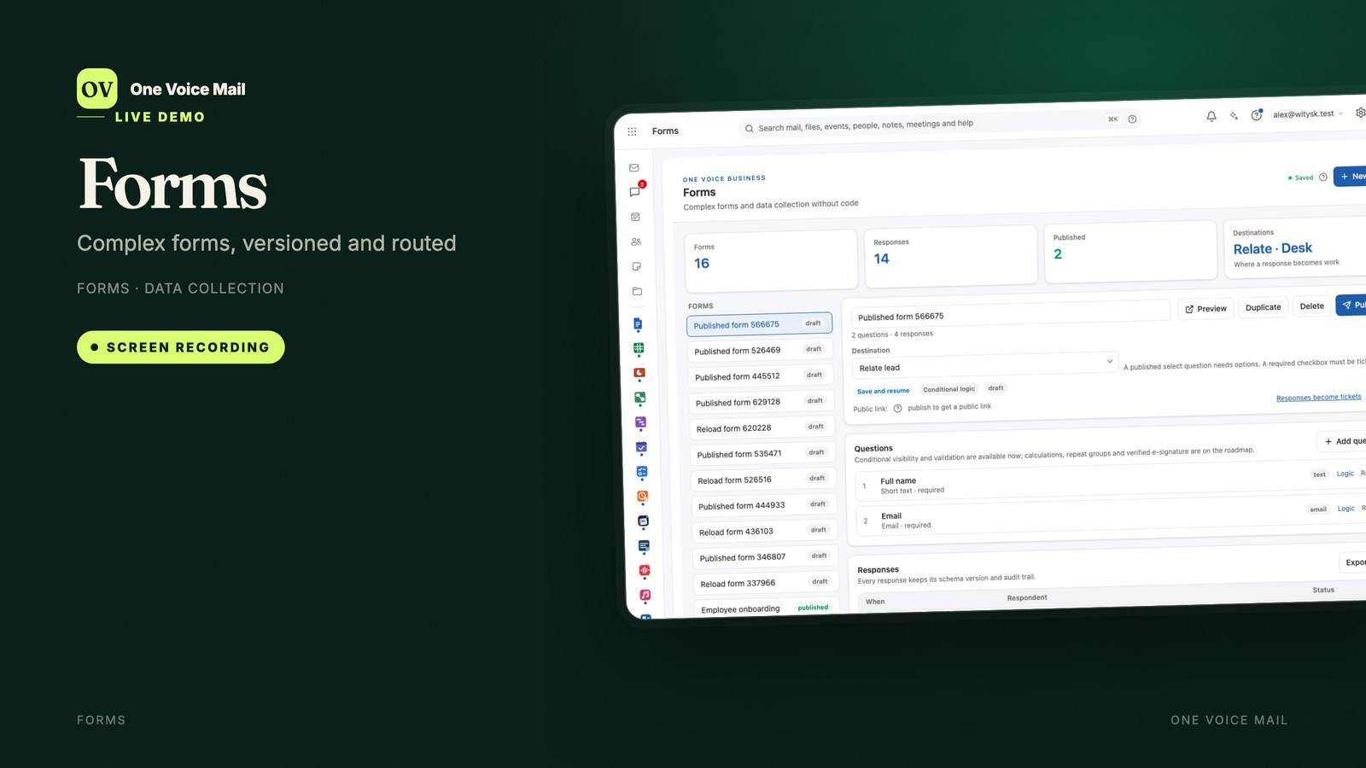
Notes:
Maya: Forms builds complex forms without code.
Alex: Short text, email, choice, checkbox, long text, number, date, file and signature questions.
Sam: Conditional logic, validation, attachments, drafts and signature evidence.
Jo: Publishing stores a versioned snapshot for the public link.
Maya: The public page accepts a response but never shows the response list.
Alex: Responses route to Relate, Desk, your email or the response inbox.
Sam: And every response keeps the version of the form it answered.
Jo: Each published form keeps its own snapshot, so long-running campaigns stay stable.
Maya: And the response inbox is searchable.

Slide 8
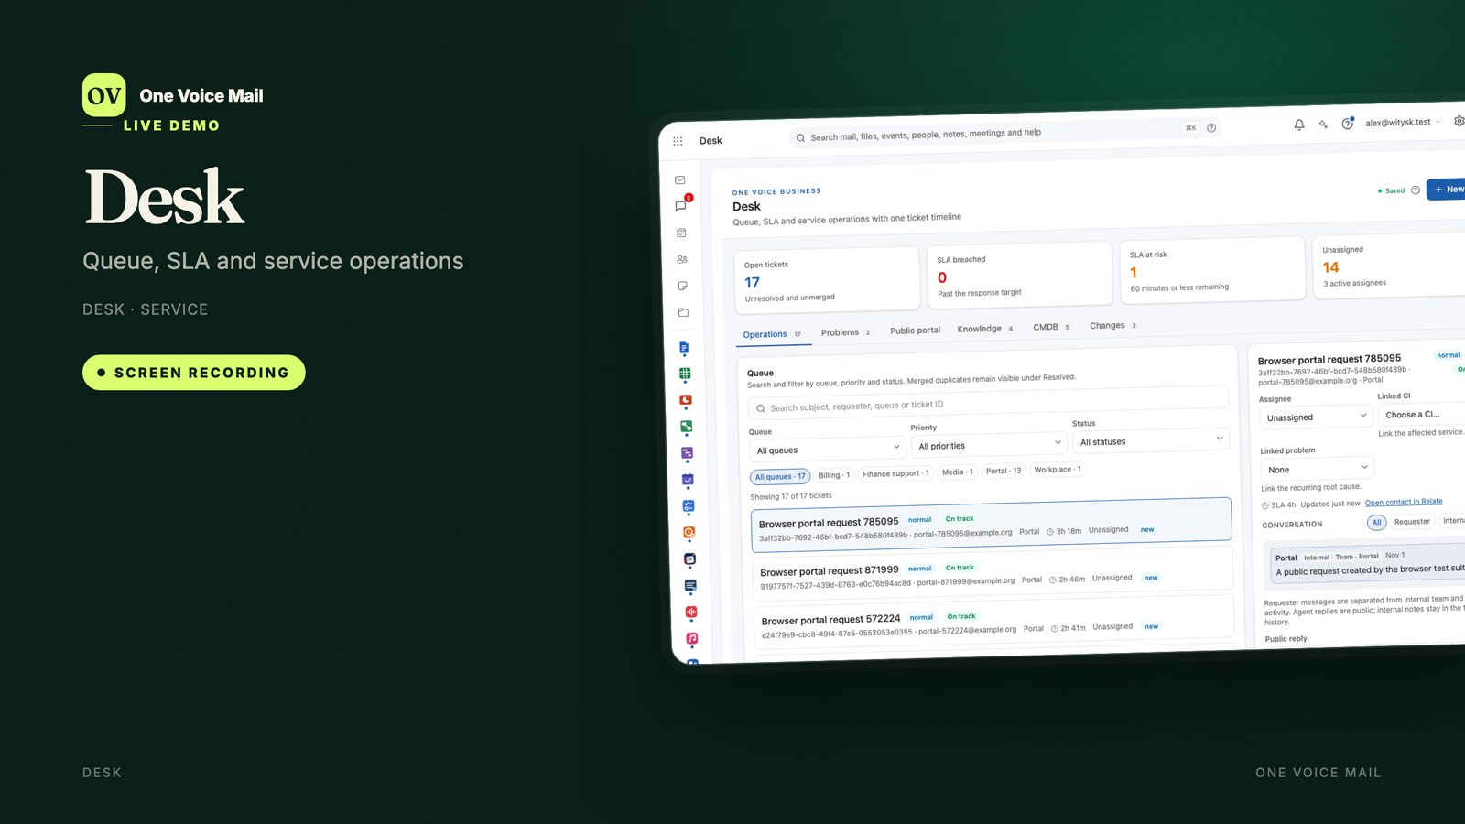
Notes:
Jo: Desk gives every request a ticket, a queue, a priority and an SLA.
Alex: Email, portal, form and API requests land in the same queue.
Sam: The SLA clock pauses while you wait for the customer, and resumes when they answer.
Maya: Configuration items show what the service depends on.
Jo: Standard, normal and emergency changes follow their own path.
Alex: Resolving a ticket can draft a knowledge article.
Maya: The public portal shows only public replies and published knowledge.
Sam: Reopen, reassign, merge and fail safely — the history stays.

Slide 9

Notes:
Alex: DBase is the no-SQL database app.
Maya: Build tables, add fields with lookups and formulas, and set record checks.
Sam: Switch between grid and report views.
Jo: Import a CSV with mapping, validation and undo.
Alex: Export the current table as CSV.
Maya: And share the app with a group.
Sam: No SQL, and no separate database to run.
Jo: Group sharing means the operations team sees the same records.
Alex: And a schema audit keeps the structure honest.
Jo: Lookups connect tables, and formulas keep records consistent.
Maya: The field builder is shared, so the schema stays under control.

Slide 10
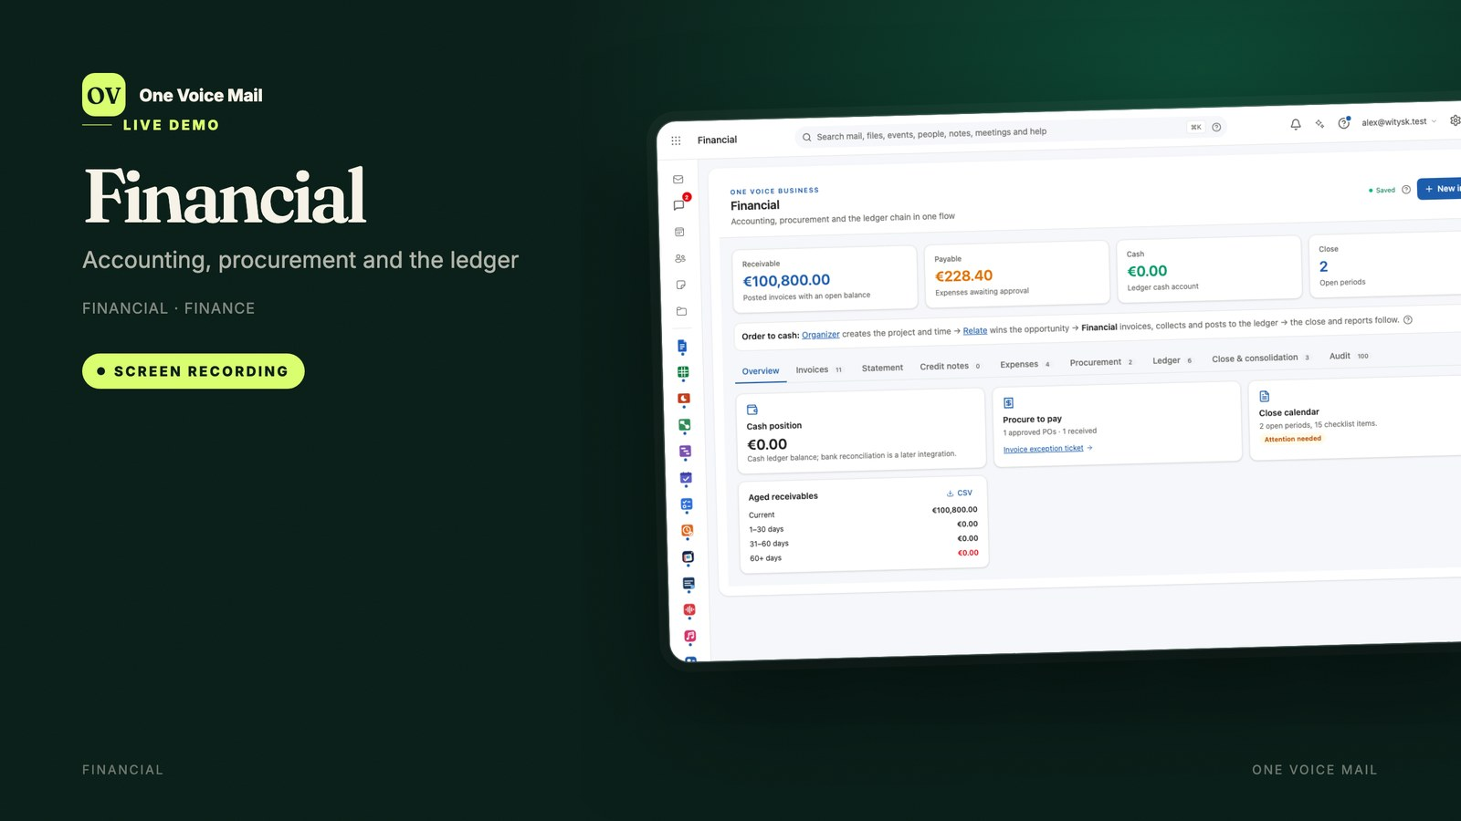
Notes:
Jo: Financial is the financial spine: invoices, expenses, purchase orders and the ledger.
Alex: It receives handoffs from Relate and Organizer.
Maya: Draft, send and mark an invoice paid; take a full or partial payment; void it or issue a credit note.
Sam: Expenses are approved or rejected, and purchase orders carry their three-way-match status.
Jo: The ledger keeps debits and credits visible, with a closed-period guard.
Alex: VAT, cash position and aged receivables are on the overview.
Maya: Consolidation and the close calendar are built in.
Sam: And the audit tab shows who saved the shared record, and when.

Slide 11

Notes:
Alex: Organizer is the operating model for the people side.
Maya: Org units, positions and reporting lines define who approves.
Sam: Future-dated changes stay pending and apply when due.
Jo: Positive time records the work that was actually done.
Alex: Expenses record cost; outgoing invoices turn delivery into cash.
Maya: Time and expense returns can be rejected with a reason.
Sam: Utilisation and cost centres are visible.
Jo: And the records are the same ones Financial uses.
Sam: Org changes are effective-dated, so next month’s structure can be prepared today.
Alex: Cost centres roll up to the units that own them.

Slide 12
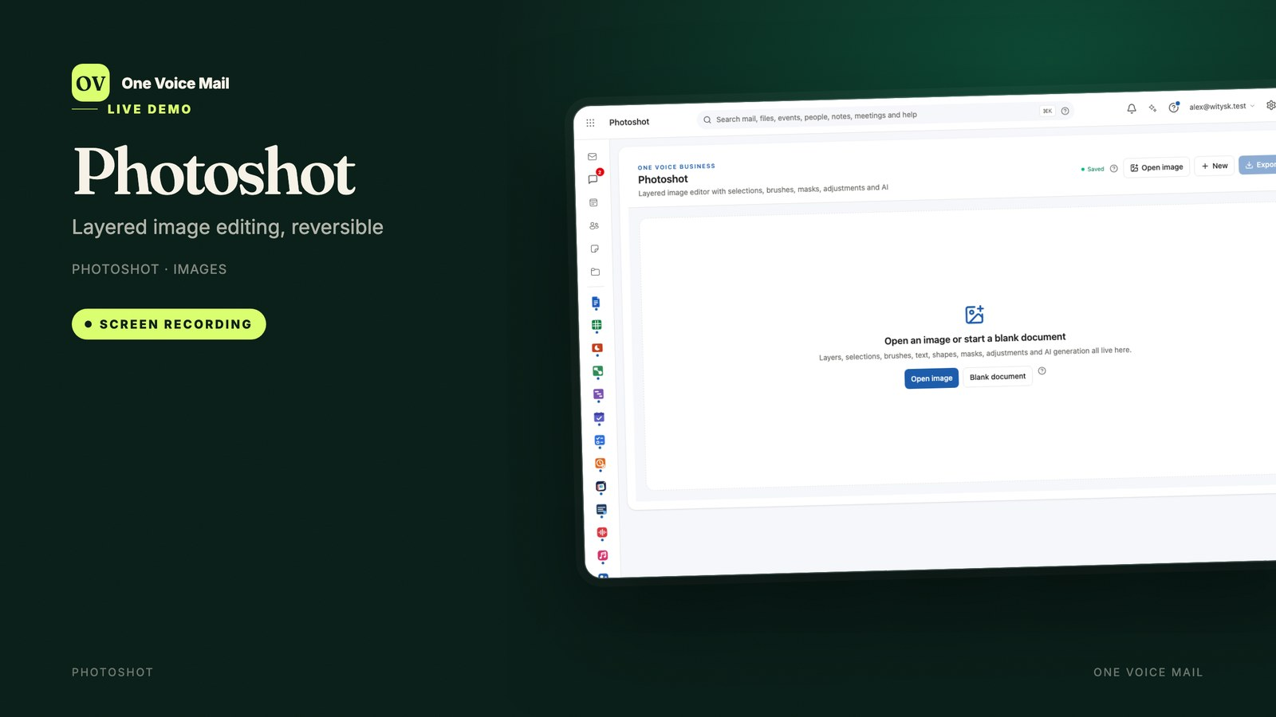
Notes:
Maya: Photoshot is the layered image editor.
Alex: It keeps the original pixels and applies adjustments as a reversible stack.
Sam: Brightness, contrast, saturation, text, masks and looks.
Jo: Export a PNG at the size and colour profile the destination needs.
Maya: Campaign images, site heroes and video thumbnails — without leaving the suite.
Sam: It is the same editor stack as the rest of the suite, so nothing new to learn.
Alex: And the original is never overwritten.

Slide 13
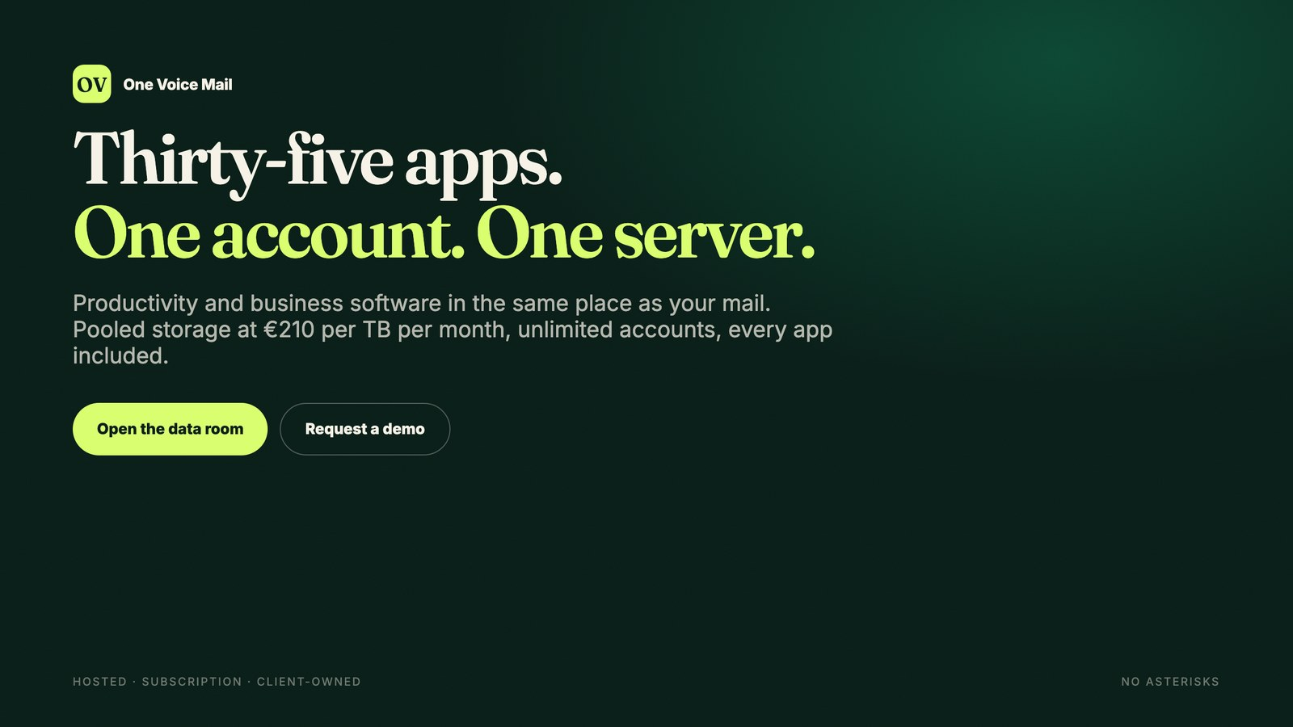
Notes:
Jo: That is the business suite: ten apps that share one customer record and one handoff.
Alex: From the first campaign to the closed ledger, the work stays in one place.
Maya: And it sits beside the mail, calendar, files and editors your team already uses.
Sam: Thirty-five apps in one account, on a server you choose.
Jo: Pricing is pooled storage, not seats: two hundred and ten euros per terabyte per month, unlimited accounts.
Alex: Hosted, subscription, or on your own hardware.
Maya: See the data room for the detail, or ask for a demo.
Sam: One platform. No asterisks.
Jo: The data room has the business plan, the financial model and the vision document.
Alex: And a demo account is available on request.

